Slide 1
Flux Transport by Convection in Late-Type Stars
(Hubeny & Mihalas 16.5)
Schwarzschild Criterion
Mixing Length Theory
Convective Flux in Cool Stars

Slide 2
Schwarzschild Stability Criterion
Does it occur?
If
will continue to rise
→ unstable
If
will sink again
→ stable
Δr
bubble
surroundings

Slide 3
Schwarzschild Stability Criterion
For an adiabatically expanding gas
Then density in bubble changes as
(assuming inner = outer pressure)
Unstable if

Slide 4
Schwarzschild Stability Criterion
Small changes
Criterion:
Taylor expand …

Slide 5
Schwarzschild Stability Criterion
Ideal gas
Substitute for dlnρ/dr in last expression
Result
Radiative gradient
Adiabatic gradient
Convective instability if
(μ=constant)

Slide 6
Adiabatic Gradient
Ideal Gas
Pure radiation pressure
Ionized H
Convection more probable
in H ionization zone

Slide 7
Radiative Gradient
Diffusion approximation at depth
Hydrostatic equilibrium
Radiative Gradient
Higher opacity → higher radiative gradient → convection more probable

Slide 8
Applications
Thin or no convection in OB stars
Convection zones established by F-types
Extend deeper later with later (cooler) stars (M-types fully convective)

Slide 9
Mixing Length Theory
How much flux is carried by convection?
Imagine blob rising in atmosphere and depositing energy after traveling distance
l = mixing length
Energy content of blob (erg cm⁻³)=ρ C_{p} δT C_{p}=specific heat at constant pressure
δT= temperature difference between blob and surrounding medium

Slide 10
Gradients of Interest
Rad. grad. in absence of conv.
Actual grad. in atmosphere
Grad. of conv. elements
Adiabatic grad.
(no energy loss)

Slide 11
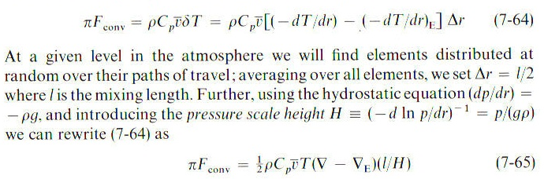
Convective Flux

Slide 12
Summary of Solution
find velocity by considering buoyant forces
(slides 13 – 14)
find one relation between Grad_true and Grad_element by considering radiative energy losses in cell (slides 15 – 18)
find one more relation between Grad_true and Grad_element by considering total flux carried by both radiation and convection (slides 19 – 21)
Algebra for solution (slides 21 – 23)

Slide 13
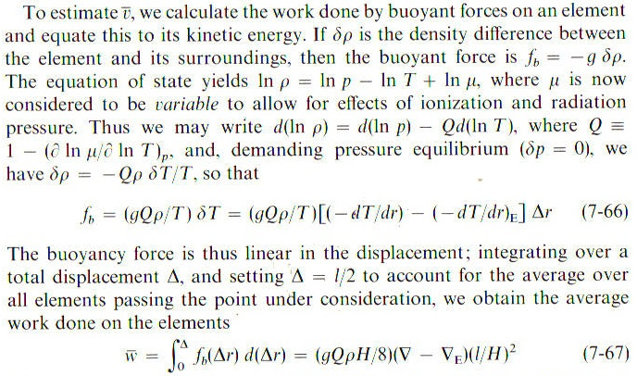
Find Mean Velocity of Cells

Slide 14
Balance Kinetic Energy with Frictional Losses
Suppose half the work goes into kinetic energy and half to frictional losses
Use this to get mean velocity
Insert into expression for flux

Slide 15
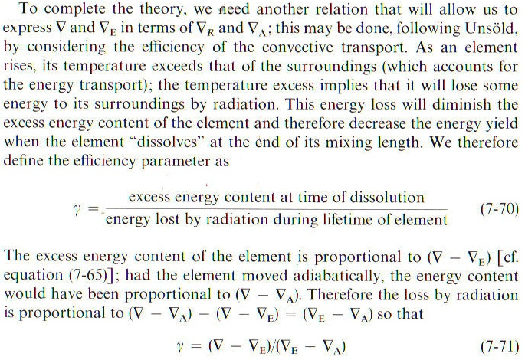
Difference in Gradients

Slide 16
Radiation Loss:
Optically thin case
Excess heat content at break up
= ρ C_{p} δT V where V = cell volume
Energy radiated
= volume emissivity x V x elapsed time =
Efficiency factor for cell opt. depth τ_{E}

Slide 17
Radiation Loss:
Optically thick case
Adopt diffusion approx.
Cell flux lost over length l, fluctuation δT
Lost over area A, elapsed time l/v
Efficiency

Slide 18
General Efficiency Relation
Interpolated in τ
Velocity
Efficiency expression

Slide 19

Are we there yet? Not quite …
Know ∇_{R}, ∇_{A};
have one equation relating ∇_{E} and∇_{true}
Need one more: flux conservation

Slide 20
Fluxes from Diffusion Approx.
Diffusion approximation
Similarly if all flux were carried by radiation

Slide 21
Insert into Flux Conservation
Add to both sides (∇_{true} - ∇_{E})+(∇_{E} - ∇_{A})
to isolate known difference ∇_{R} - ∇_{A}

Slide 22
Solution
LHS:
RHS:
(replace last term with expression for the efficiency argument on page 18)
Substitute x ≡ (∇ _{true} - ∇ _{E})^{½}
Solve for

Slide 23
Solution
Suppose solution of cubic equation is x₀
From efficiency equation (page 17)
Definition of x
Final expression (page 14)

Slide 24
Method
Start with model atmosphere with initial
T(τ) relationship (ex. grey atmosphere)
Check how pressure varies with depth
from equation of hydrostatic equilibrium
Use first moment expression for radiation pressure gradient
Gas pressure gradient from

Slide 25
Method
Calculate radiative, adiabatic gradients, and check Schwarzschild criterion∇ _{A}<∇ _{R}
If convection occurs, solve for ∇ _{true} , ∇ _{E}
as we did above
Revise T(τ) scale at next depth point with ∇ _{true} and iterate upwards
Revert to radiative transfer if ∇ _{A} >∇ _{R}

Slide 26
Solar Atmosphere: Granulation
π F_{conv} = ρ C_{P} v δT
≈10⁻⁷ g cm⁻³ 10⁸ erg g⁻¹ K⁻¹ 10⁵ cm s⁻¹ 100 K
= 10⁸ erg cm⁻² s⁻¹
versus
10¹¹ erg cm⁻² s⁻¹ for π F_{rad}
Convection not too important in outer layers (only deeper)

