Slide 1
Stellar Properties
Basic Data
Mass and Radius
Spectral Classification
Photometric Systems

Slide 2
Simbad database
http://simbad.u-strasbg.fr/simbad/sim-fid
Search by name or coordinate to get all names coordinates proper motion parallax magnitudes spectral type radial velocity references

Slide 3
Vizier catalogue search
http://vizier.u-strasbg.fr/viz-bin/VizieR
Useful if you know catalogue number example: GAIA DR2 = I/345
Can also do comprehensive search on identifier (may be more than you want!) “Search by Position across 19591 tables”

Slide 4
Stellar Masses and Radii
Eclipsing binaries are the fundamental source but …
Interferometry (CHARA Array) can yield: ang. diameter + parallax → radius wide binary angular orbit + radial velocity curve → masses (and distance)
Compendium of binary data by Torres, Andersen, & Gimenez (2010, A&ARv, 18, 67)

Slide 5
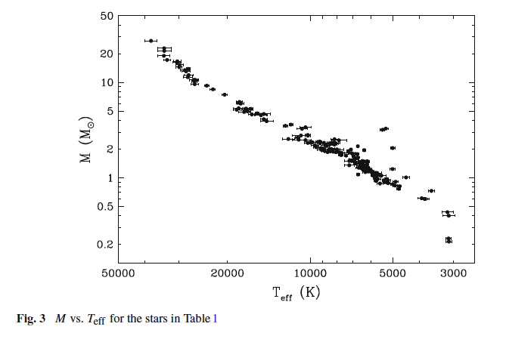

Slide 6
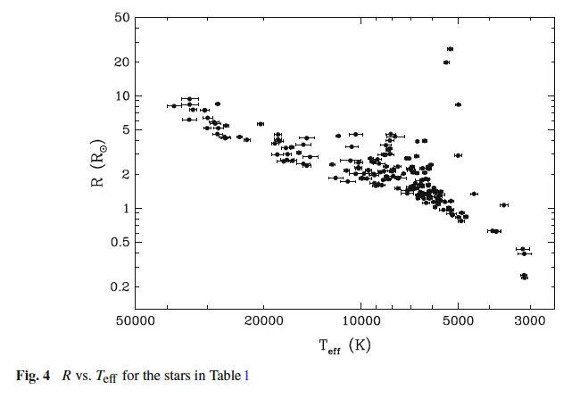

Slide 7
CHARA Version
Ang. Size + distance gives R
Ang. Size and SED gives T_{eff}
L from T_{eff} and R
log L (L⊙)
Empirical Hertzsprung-Russell Diagram showing ~290 stars with sizes measured with long-baseline optical/infrared interferometry (from von Braun & Boyajian 2017, in Extrasolar Planets and Their Host Stars, Springer). All of the stars have stellar radii with random uncertainties smaller than 5%, stellar radii < 100 Rsun, and distances up to 150 pc. The size of the plotting symbols corresponds to the logarithm of the stellar radius.

Slide 8
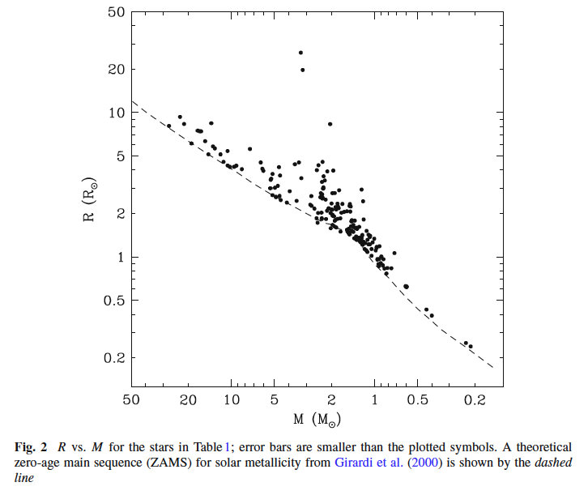

Slide 9
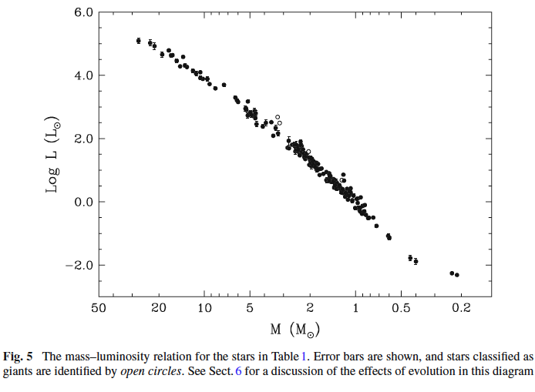

Slide 10
Spectral Properties
Ideally we want flux calibrated, wavelength calibrated, high S/N, and high resolution spectrum covering the entire electromagnetic spectrum
Reality is different
How can we characterize spectral properties in a simple way?

Slide 11
Spectral Classification
Use the patterns of absorption lines to assign stellar spectrum to a specific spectral type and luminosity class
Empirical system based upon uniform set of (blue) spectra with same resolution
Begun at Harvard as part of Henry Draper Memorial program of photographic spectroscopy by Annie Jump Cannon (first published in 1901: OBAFGKM)

Slide 13
Spectral Classification
Built upon comparisons with standard stars defined in the Morgan-Keenan (MK) system (MK boxes like integers)
Spectral type (letter and number) plus luminosity class (Roman numeral)

Slide 14
Spectral Classification
Largest sample of MK classifications by Nancy Houk (Univ. Michigan) (5 volumes)
See handout for her classification notes
This photo shows Nancy Houk with Mike Castelaz from the Astronomical Photographic Data Archive (APDA) in 2004 when her collection was loaded on a vehicle for transfer to APDA at Pisgah Astronomical Research Institute, Rosman, NC.

Slide 15
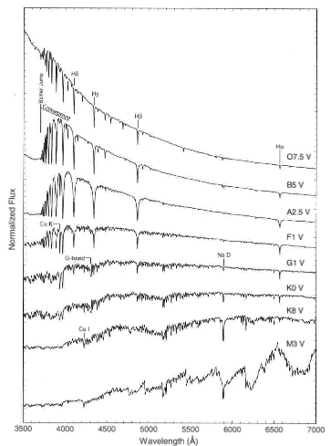

Slide 16
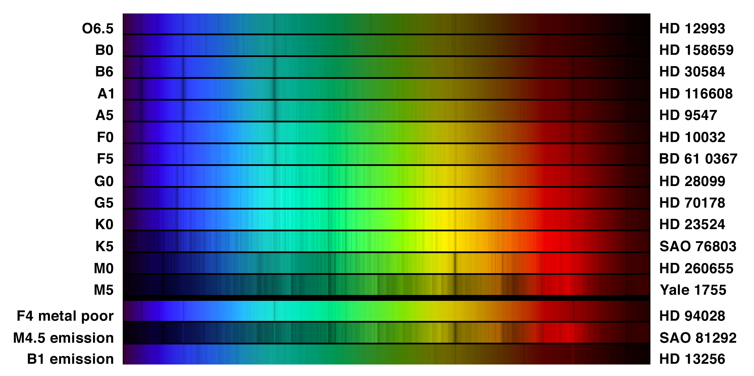

Slide 17
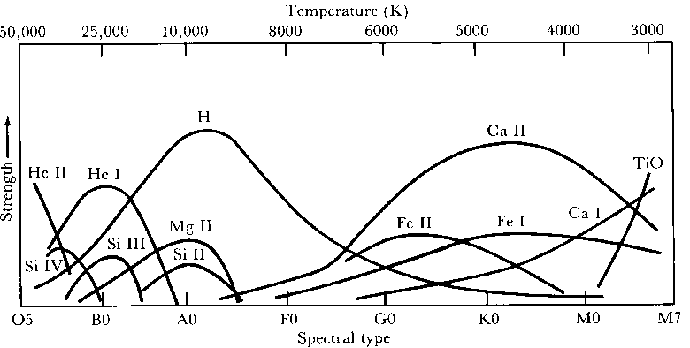
Spectral Class related to Effective Temperature

Slide 18
Richard Gray’s Spectral Atlas: spectral type and luminosity class
http://nedwww.ipac.caltech.edu/level5/Gray/frames.html
Ia-O extremely luminous supergiants Ia luminous supergiants Ib less luminous supergiants II bright giants III normal giants IV subgiants V main sequence dwarf stars VI, or sd subdwarfs D white dwarfs

Slide 19
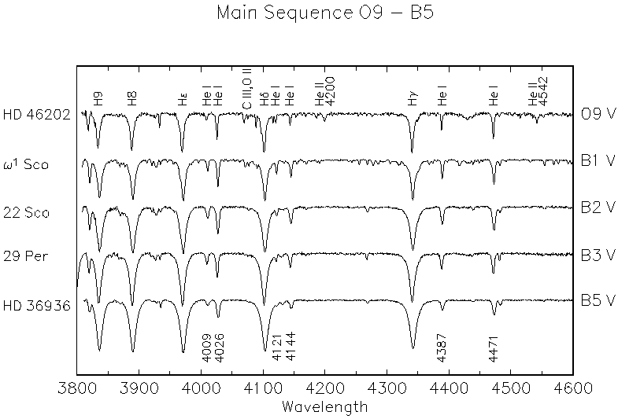

Slide 20
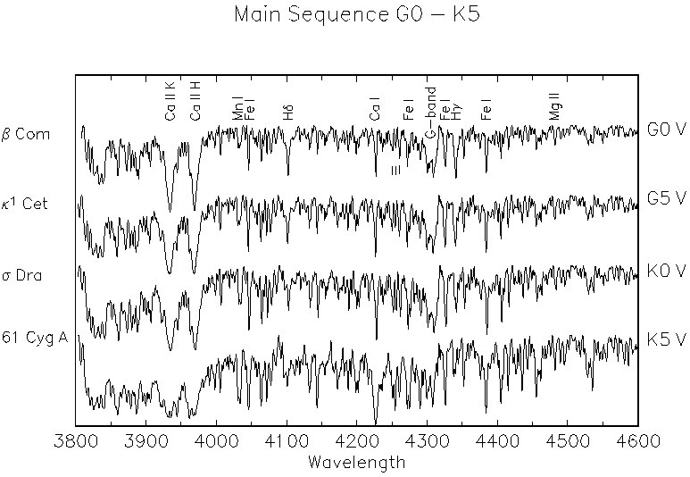

Slide 21
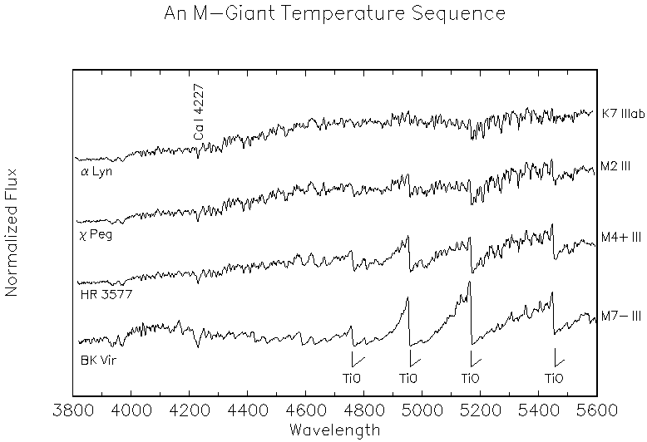

Slide 22
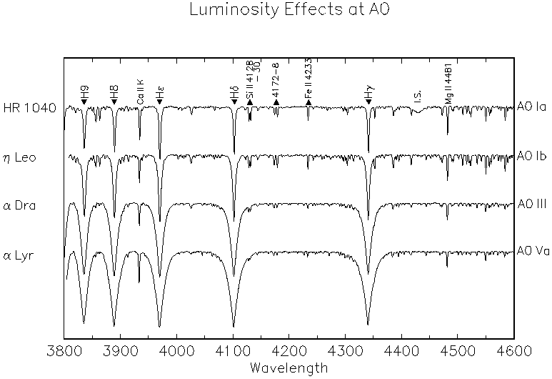

Slide 23
Magnitudes and Colors
Poor man’s spectroscopy: bin all the light across wavelength bands defined by standard filters
Advantages: relatively easy and good for fainter targets
Disadvantages: need good conditions (“photometric”) for reliable measurements that can be transformed to standard systems (but little or no spectral line data)

Slide 24
Magnitude Relations
Magnitude
Mag. Difference
Absolute Mag.
Bolometric Mag.

Slide 25
Magnitude Scales and Photometric Systems
Bessell (2005, ARA&A, 43, 293) Casagrande & VandenBerg (2014, MNRAS, 444, 392)
Consider color sensitivity of detector (eye, photographic plate, phototube, CCD, etc.)
Use with set of standard filters (usually designed with some express purpose to measure a specific feature in the spectral energy distribution)

Slide 26
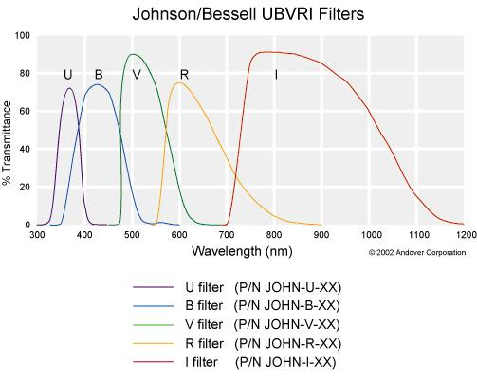
Johnson-Cousins System

Slide 27
Other Systems: Trade off between spectral resolution and sensitivity
Geneva
Stromgren intermediate band
Photographic
HST WFPC2
Hipparcos/Tycho
Sloan Digital Sky Survey
2MASS near-IR
GAIA

Slide 28
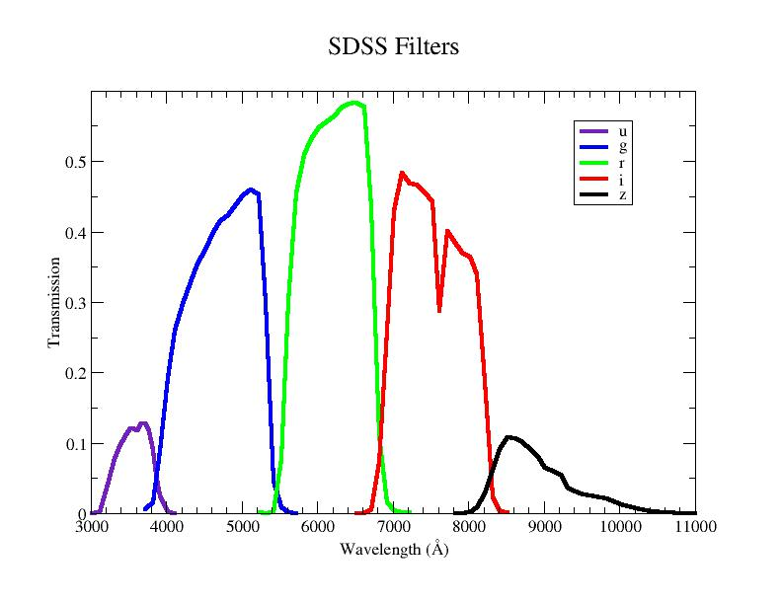

Slide 29
GAIA Filters

Slide 30
