Slide 1
Radiative Field (Hubeny & Mihalas Chapter 3)
Specific Intensity I and its angular moments: Mean Intensity J Flux H Radiation Pressure K

Slide 2
Specific Intensity I

Slide 3
Specific Intensity
Vector
Units:
for one dimensional case where z is height in atmosphere measured positive upwards
Applied to resolved objects
Independent of distance

Slide 4
Compare to Photon Description

Slide 5
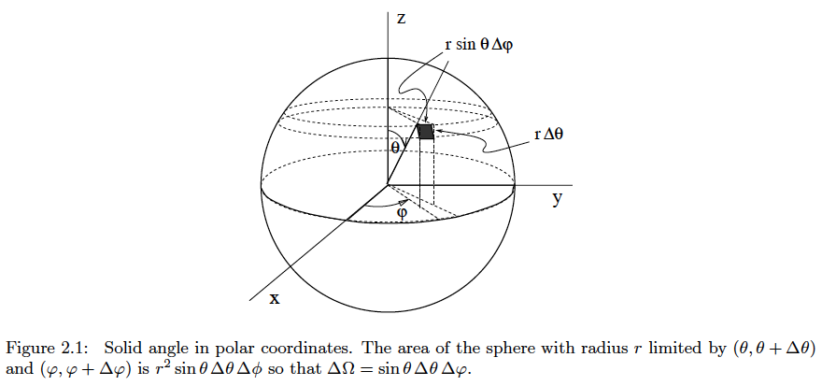
$$ΔΩ ≡dω$$

Slide 6
Mean Intensity J
Scalar:
z
I

Slide 7
J and Energy Density

Slide 8
Total Energy Density
Total energy density across spectrum
Thermal equilibrium (deep in star) J=B

Slide 9
Flux F

Slide 10
Flux in 1-D Atmosphere
Defined only in z direction
Astrophysical flux (see Kurucz 1979)
Eddington flux

Slide 11
Surface and Observed Flux
$r= r_{∗}$ $\sin{θ}$
$dr= r_{∗}$ $\cos{θ} dθ$
$dS=2 π r_{∗}^{2}$ $\sin{θ}$ $\cos{θ}$ $dθ$

Slide 12
Surface and Observed Flux

Slide 13
Integrated Flux and Stellar Effective Temperature
monochromatic
bolometric
Stefan’s law
relation

Slide 14
Radiation Pressure Tensor

Slide 15
Physical Meaning: Photon Distribution Function
# photons/sec passing unit area oriented with normal in i direction
E/c =momentum/photon

Slide 16
Mean Radiation Pressure

Slide 17
K in1-D Case: see hand out

Slide 18
Isotropic case (deep in star)

Slide 19
Plane wave (outer atmosphere)
Variable Eddington factor = K / J changes from 1/3 (deep) to 1(outer)

