Slide 1
Basic LTE Relations (Hubeny & Mihalas 4)
Planck Curve Maxwellian Velocity Distribution Boltzmann Excitation Relation Saha Ionization Equation

Slide 2
Planck (Black Body) Spectrum
Good description of radiation field deep in the atmosphere where little leakage occurs

Slide 3
Planck (Black Body) Spectrum
Wien’s law: peak of the λ curve in Ångstroms
Stefan-Boltzman law: area under the curve, σ = 5.6705x10⁻⁵ erg s⁻¹ cm⁻² K⁻⁴

Slide 4
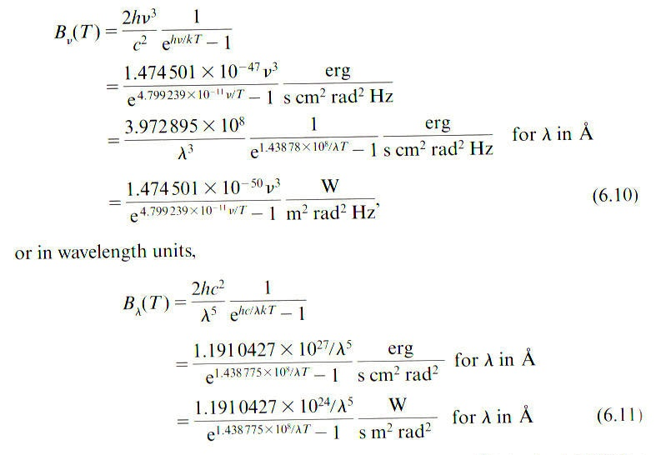

Slide 5
Planck curve in IDL
Wave=10.*(findgen(1000)+1.) ; 10,20,…10000 Ångstroms
Teff=30000. ; Kelvin
B=planck(wave,teff) ; Planck function
Applet at jersey.uoregon.edu/vlab

Slide 6
State of Gas in LTE (T, N)
Maxwellian velocity distribution

Slide 7
Boltzmann Excitation Equation
n_{ijk} = number density of atoms of excitation state i ionization state j chemical species k
Χ_{ijk} = excitation energy of state i relative to ground state of atom/ion, Χ_{0jk}
g_{ijk} = statistical weight (# degenerate sublevels, 2J+1)
Ludwig Boltzmann

Slide 9
Partition Functions
Dependent on T
log U(T) tabulated in Gray, Appendix D.2, as function of

Slide 10
Saha Ionization Equation
Χ_{I} = ionization potential energy above ground state to ionize the atom
Listings in Gray, Appendix D.1
Meghnad Saha

Slide 13
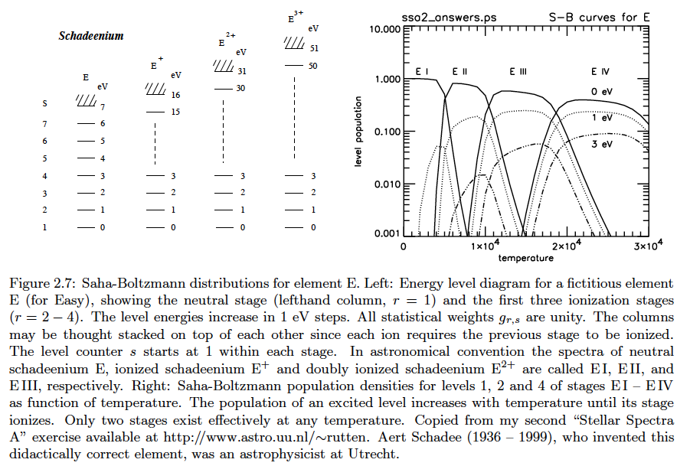

Slide 14
Key Variables: T, n_{e}
Hubeny & Mihalas Chap. 17 give a general iterative method to find n_{e} from T and N, where N=total number of particles
Interesting limiting cases …

Slide 16
