Slide 1
Absorption Cross Sections
(Hubeny & Mihalas Chapter 5)
Bound-bound transitions
(Einstein relations)
Bound-free transitions
(Einstein-Milne relations)

Slide 2
Bound-Bound Transitions
Balance transitions between two levels
Upwards absorption
Downwards by spontaneous or stimulated emission
j
hν_{ij}
i

Slide 3
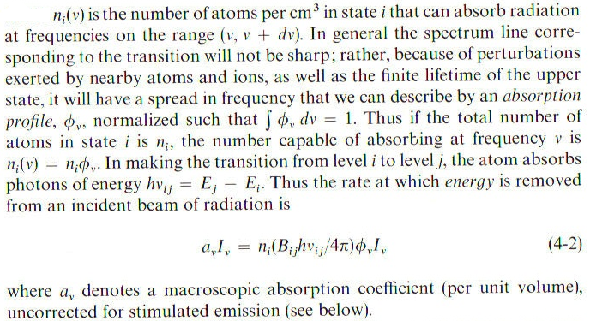
Energy Absorption Rate: B_{ij} = Einstein coefficient for absorption

Slide 4
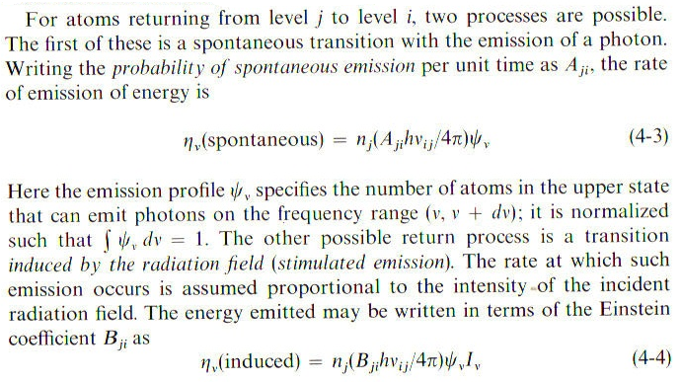
Return Rates:
A_{ji}=Einstein coeff. spontaneous em.
B_{ji}=Einstein coeff. stimulated em.
(isotropic)
(same direction as I_{ν})

Slide 5
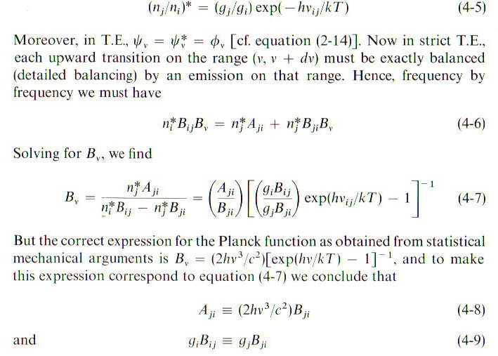
*Thermodynamic Equilibrium: I_{ν}=B_{ν}

Slide 6
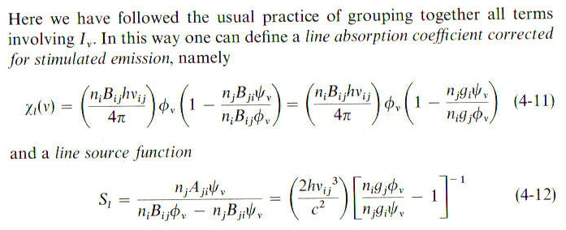
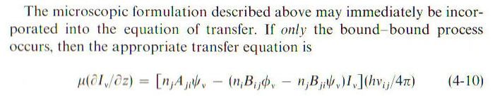
b-b Transfer Equation

Slide 7
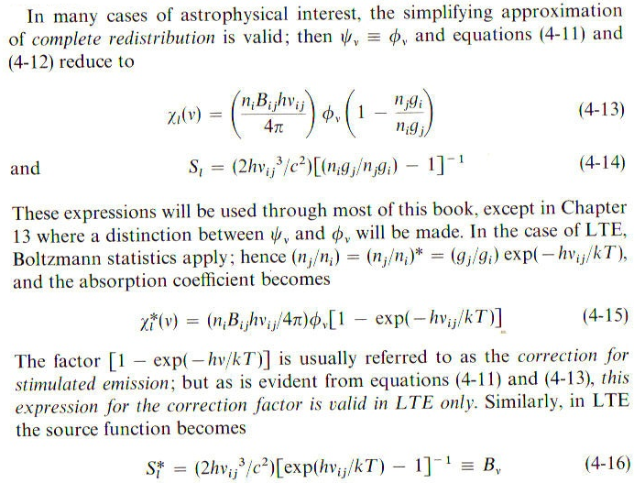
b-b Transfer Equation

Slide 8
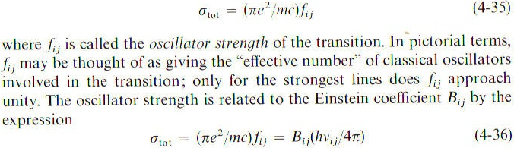
Transition Rates
Calculate or measure cross section

Slide 9
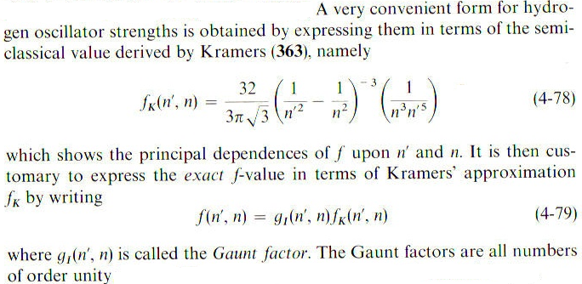
Transition Rates: Hydrogen
H transitions n'→n

Slide 10
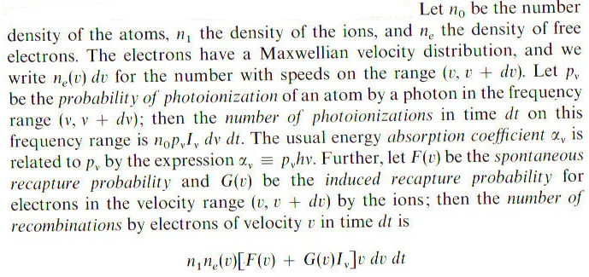
Einstein-Milne Relations for
Bound-Free Transitions

Slide 11
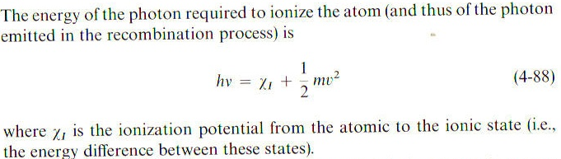
Einstein-Milne Relations: energy and velocity
Replace v dv increment in recombination term with this.

Slide 12
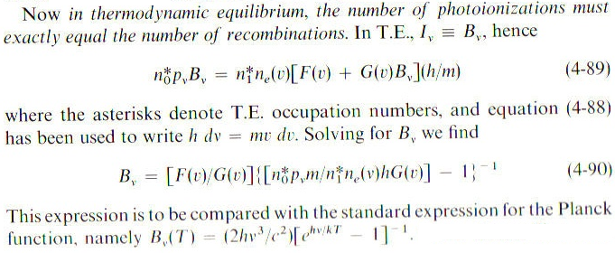
Einstein-Milne Relations:
#photoionizations=#recombinations

Slide 13
Denominator Term:
Maxwell dist. n_{e}(v); Saha eq. n₀/n₁
…….=1. ……

Slide 14
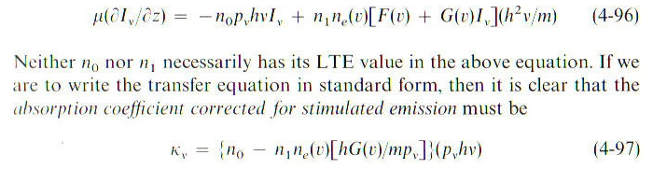
b-f Transfer Equation
T.E.: α_{ν}=p_{ν}hν , n_{e}=Maxwellian, n₀*/n₁*=Saha, G(v)/p_{ν} above …

