Slide 1
Continuum Absorption (Hubeny & Mihalas 7; Gray 8)
H b-f, f-f H⁻ opacity Other sources Scattering

Slide 2
H bound-free

Slide 3
H bound-free

Slide 4
H bound-free
Final result is sum over all levels that can be ionized by photon of given frequency
Dominant in spectral types B, A

Slide 5
H free-free
Electron moving close to proton
Photon absorbed … energy into velocity of the electron
Photon emitted … energy from velocity of the electron (bremsstrahlung)

Slide 6
H free-free

Slide 7
H free-free

Slide 8
Negative Hydrogen Ion H⁻

Slide 9
Negative Hydrogen Ion H⁻

Slide 10
Negative Hydrogen Ion H⁻
Cannot exist in hot stars because collisions destroy H-
Can’t exist in cool stars because free electrons needed (from metals)
Dominant in G, K type stars
b-f
f-f

Slide 11
Molecular Hydrogen
H₂⁻ (free-free) in very cool stars
H₂⁺ (bound-free) in A, F stars where equal numbers of neutral H and protons exist

Slide 12
Helium
He I bound-free, free-free in early B stars (threshold λ<504 Angstroms)
He II bound-free, free-free in O stars (threshold λ<227 Angstroms)
He⁻ free-free in cool stars, long wavelength

Slide 13
Metals
Small abundances but still can produce significant bound-free absorption (UV)
Molecules (free-free) in very cool stars: CN⁻, C₂⁻, H₂O⁻ (plus bound-bound molecular bands)

Slide 14
Scattering
Thomson scattering by free electrons
Use Klein-Nishina formula for X-rays
Important in O stars
Rayleigh scattering by atoms or molecules (important in blue, UV in cool stars)

Slide 15
Sum over all absorption coefficients: net opacity [cm²/H particle, cm²/g]
See hand-out summary from Collins (1989)
Tabular data (Allen’s AQ), but in most codes calculated for each source of opacity
Example plots in Gray and Bohm-Vitense

Slide 18
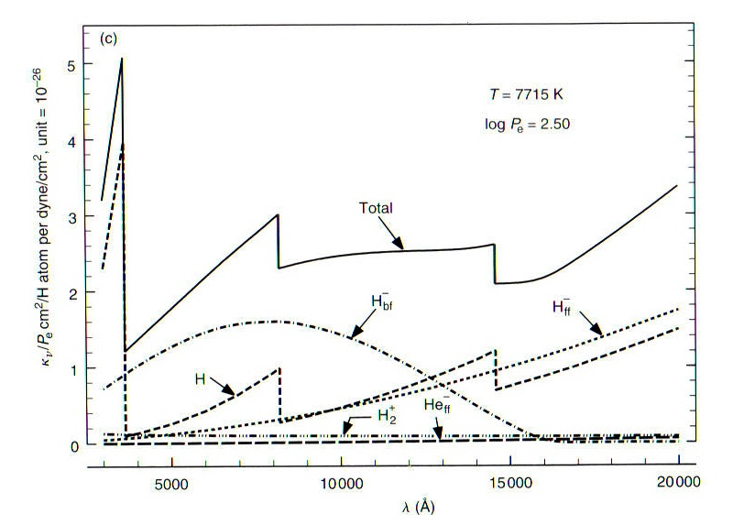

Slide 19
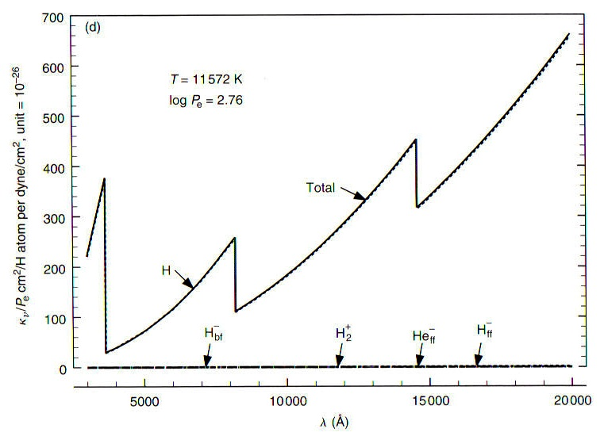

Slide 20
