Slide 1
Analytical Relations for the Transfer Equation (Hubeny & Mihalas 11)
Formal Solutions for I, J, H, K Moments of the TE w.r.t. Angle Diffusion Approximation

Slide 2
Schwarzschild – Milne Equations
Formal solution
Specific intensity
Mean intensity
Eddington flux
Pressure term

Slide 3
Semi-infinite Atmosphere Case
Outgoing radiation, μ>0
Incoming radiation, μ<0
z
Τ=0

Slide 4
Mean Field J (Schwarzschild eq.)

Slide 5
F, K (Milne equations)

Slide 6
Operator Short Forms
J = Λ
F = Φ
K = ¼ Χ
f(t) = S(t) Source function

Slide 7
Properties of Exponential Integrals

Slide 8
Linear Source Function S=a+bτ
J =
For large τ
At surface τ = 0

Slide 9
Linear Source Function S=a+bτ
H = ¼Φ(a+bτ)
For large τ, H=b/3 (gradient of S)
At surface τ = 0

Slide 10
Linear Source Function S=a+bτ
K = ¼ Χ(a+bτ)
Formal solutions are artificial because we imagine S is known
If scattering is important then S will depend on the field for example
Coupled integral equations

Slide 11
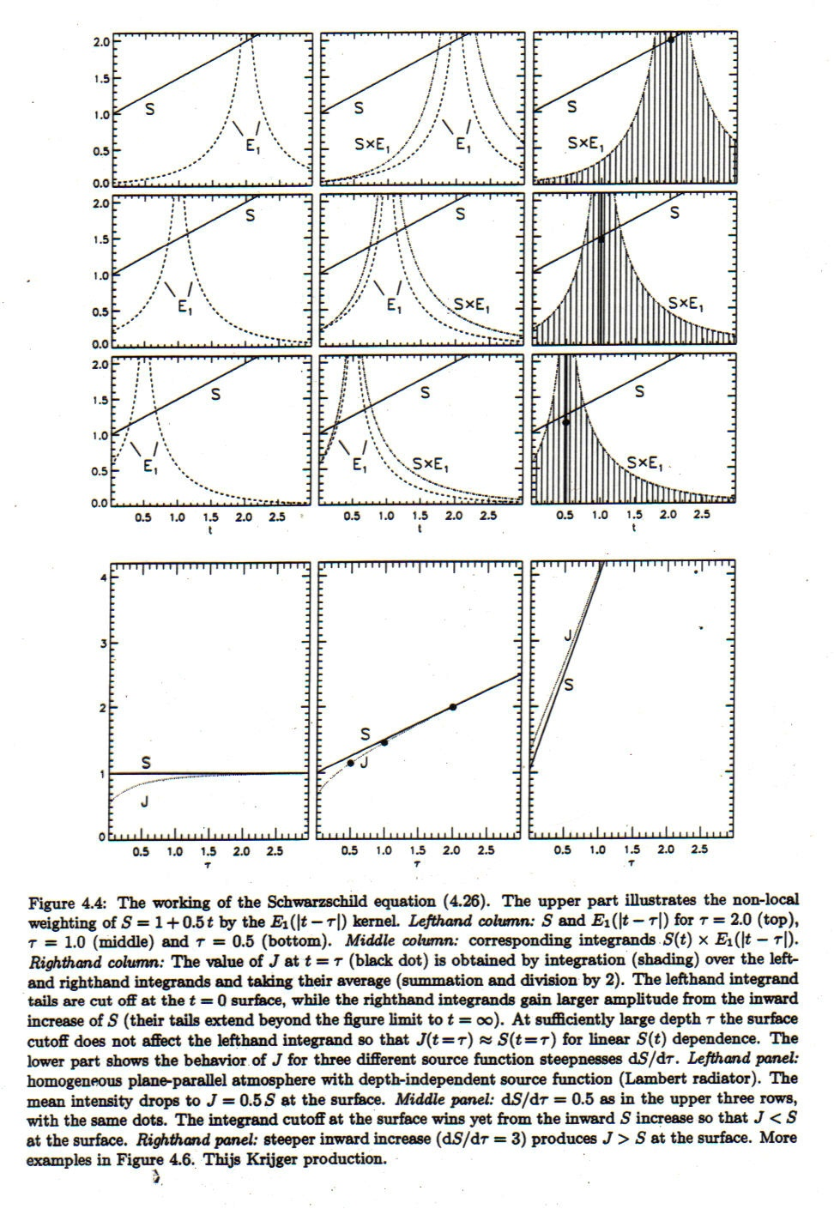

Slide 12
Angular Moments of the Transfer Equation
Zeroth moment and one-D case:

Slide 13
Radiative Equilibrium

Slide 14
Next Angular Moment: Momentum Equation
First moment and one-D case:

Slide 15
Next Angular Moment: Momentum Equation
Radiation force (per unit volume) = gradient of radiation pressure
Further moments don’t help … need closure to solve equations
Ahead will use variable Eddington factor f = K / J

Slide 16
Diffusion Approximation (for solution deep in star)

Slide 17
Diffusion Approximation Terms

Slide 18
Only Need Leading Terms

Slide 19
Results
K / J = 1/3
Flux = diffusion coefficient x T gradient
Anisotropic term small at depth

