Slide 1
Grey Atmosphere (Hubeny & Mihalas 17, 13)
Eddington Approximation Solution Temperature Stratification Limb Darkening Law Λ-iteration, Unsőld iteration Method of Discrete Ordinates

Slide 2
Grey or Constant Opacity Case
Simplifying assumption Χ_{ν} = Χ independent of wavelength
OK in some cases (H⁻ in Sun; Thomson scattering in hot stars)
Good starting point for iterative solutions
Use some kind of mean opacity

Slide 3
Mean Opacities
Flux weighted mean (radiation pressure)
Rosseland mean (good at depth; low opacity weighted)
Planck mean (good near surface; near rad. equil.)

Slide 4
Frequency Integrated Form of TE
TE
Radiative equilibrium
Recall moments of TE:
Apply Eddington approximation K/J = 1/3
H=F/4=conserved quantity
q= Hopf function in general

Slide 5
Constant from Surface Flux

Slide 6
Grey E.A. Limb Darkening Law

Slide 7
Improvements by Iteration
All based on K/J=1/3 which is too small close to the surface
Flux is not rigorously conserved (close)
Two improvement schemes used to revise the grey solution and bring in closer to an exact solution: Lambda Λ and Unsőld iteration methods

Slide 8
Λ Iteration
Further iterations possible, but convergence is slow since operator important only over photon free path.

Slide 9
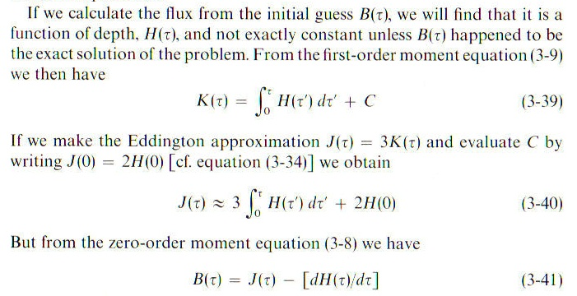
Unsőld Iteration
*
*

Slide 10
Unsőld Iteration

Slide 11
Unsőld Iteration
Initial estimate
Work out ΔH and ΔB
Next estimate
Converges at all depths

Slide 12
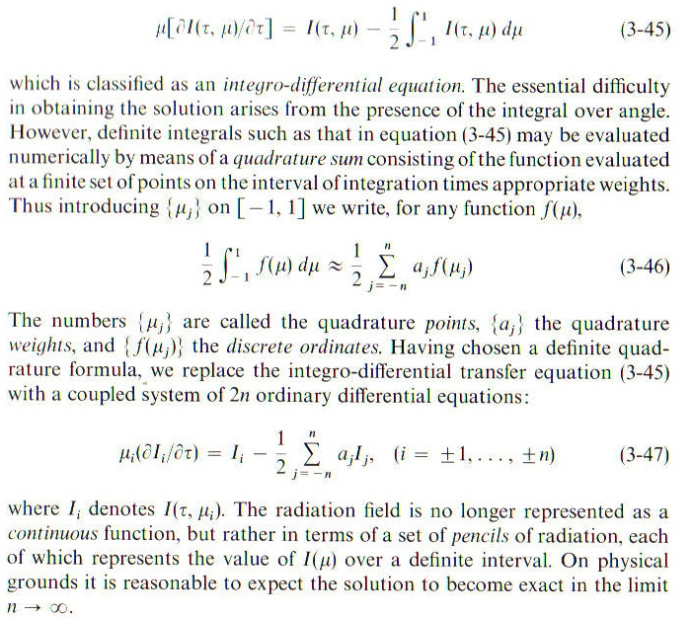
Discrete Ordinates: Use S=J

Slide 13
Trial Solution & Substitution

Slide 14
Roots of Characteristic Function

Slide 15
Roots of Characteristic Function

Slide 16
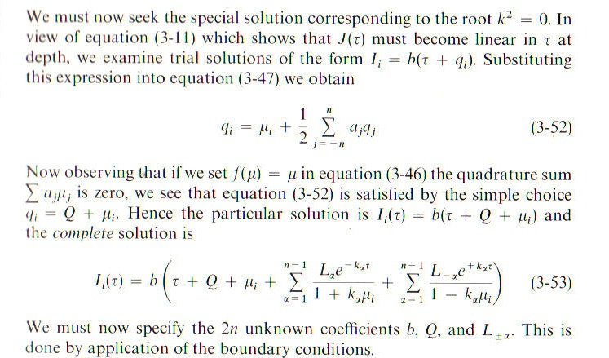
Linear term & Full Solution

Slide 17
Boundary Conditions
Lower limit on semi-infinite atmosphere
No incident radiation from space at top (n equations, n unknowns for Q, L_{α})
Set b according to flux

Slide 18
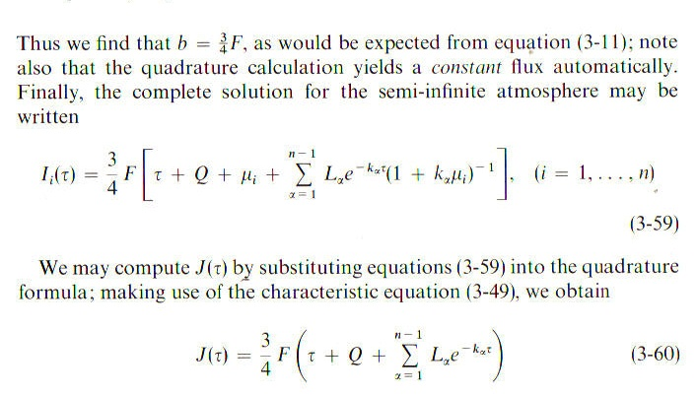
Final Solution
Good even with n small (better than 1% for n=3)

Slide 19
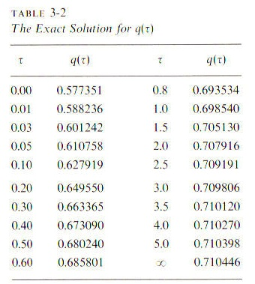
Exact Solution

Slide 20
Next steps …
Grey atmosphere shows general trends
But need to account for real opacities that are frequency dependent
Need to check if temperature gradient is altered by convection, another way stars find to transport flux outwards

