Slide 1
Wolf-Rayet Stars and Luminous Blue Variables
Ilija Medan

Slide 2
Wolf-Rayet (WR) Stars
Evolved stars with O-type star progenitors with a minimum mass of 25 $M_{⊙}$
WR stars typically have mass of 10-25 $M_{⊙}$ (massive winds with mass loss of ${10}^{−5} M_{⊙} {yr}^{−1}$)
Winds are optically thick in the optical/UV
Spectra consist of strong emission lines and weak hot continuum
Two sequences of WR stars: nitrogen sequence (WN) and carbon sequence (WC)
Notes:
-that continuum is still formed by the wind, so the photosphere is not visible in WR stars
-sequence is result of products of the CNO cycle (hydrogen burning) in WN stars and triple alpha process (helium burning) in WC stars

Slide 3
Optical Classification
Beals (1938) classification system
Important for establishing ionization class
Primarily uses ratio $He I λ5875$/$He II λ5412$
Smith (1968) classification system
Found issues with Beals system
Proposed system that determined ionization class based on nitrogen lines for WN stars and carbon lines for WC stars
Will use this system in subsequent slides
Note: these have never been defined in terms of standards
Notes:
- Main issues with beals system were that spectra could be indentical besides they strength of helium lines and in some cases therse lines are too weak making ratios difficult to calculate

Slide 4
Optical Classification – WN Stars
Based on which ionization state of nitrogen predominates spectrum
$N III: λ4634−λ4641$ (blend), $λ5314$
$N IV: λ3479−λ3484$ (blend), $λ4057$
$N V:λ4603, λ4619, λ4933−λ4944$ (blend)
Generally higher ionization predominates early classes and lower ionization later
Still uses helium lines to differentiate WN7 and WN8 stars

Slide 5
Optical Classification – WN Stars
WN3: N V strongest species
WN4: N V and N IV roughly equal
WN5: all species similar
WN6: N IV and N III roughly equal
WN7: N III strongest (also weak He I, N III< He II)
WN8: N III strongest (also strong He I, N III= He II)

Slide 6
Optical Classification – WC Stars
Based line ratios of:
$C III λ5696$/O$V λ5590$
$C IV λ5808$/$C III λ5696$
Smith (1990) further refined this classification
Redefined class determinations in terms of ratios defined by peak flux and equivalent width
Crowther et al. (1998) says Smith system subject to false classifications due to changes in C/O abundances
Add ratios: $C IV λ5808$/C$II λ4267$, He II$λ4686$/He I$λ5876$
Notes:
- Crowther system only results in a few reclassifications

Slide 7
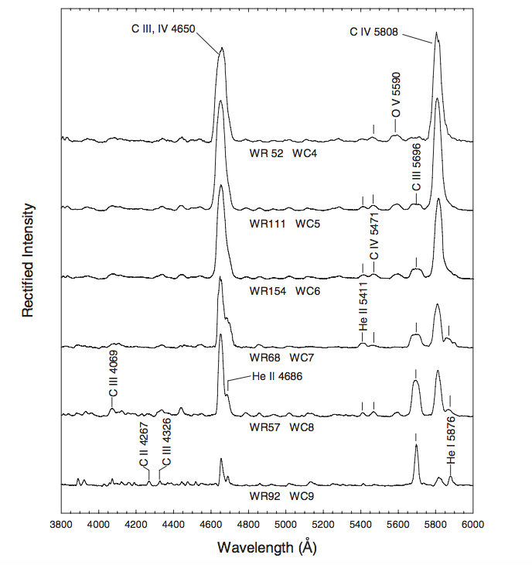
Optical Classification – WC Stars
Ratio of C III/O V increases to later types (unity at WC5)
O V disappears after WC6
Ratio of C IV/ C III decreases to later types (unity at WC8)
Crowther lines apparent in late types
Notes:
-important part of smith 1990 system that importance of ratios changes over at WC6

Slide 8
Optical Classification – WC Stars
Misclassifications can be common for later stars (WCL stars)
Usually confused with central stars of planetary nebulae (CSPNe)
These are written with closed brackets (i.e. [WC10])
Main difference in spectra is show greater range of line strengths and widths
WC10 and WC11 stars exclusively CSPNe

Slide 9
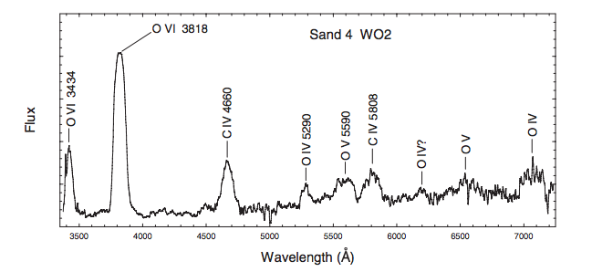
Optical Classification – WO Stars
Sanduleak (1971) identified 5 stars with strong O$IV λ3818$ emission
Four out of five also show other ionization species of oxygen and only one ion of carbon
Classification system created for WO1 to WO5 based on O IV, O V, O VI and C IV
In reality, these stars are result of higher ionization (not abundance differences)
Notes:
-So, these are just high ionization extension of WC class!
-book doesn’t have examples of sequence, so wont spend time on it
-look at table in handout

Slide 10
Issues with Smith (1968) System
Too many stars don’t fit system and are simply called “peculiar”
Both narrow-line and broad-line WN stars
From Pickering series of He II: variation in H/He abundance
Evidence that strengths of N IV lines not only dependent on ionization
Influenced by excitation processes and optical depth effects in the wind
Notes:
Can get broad line or narrow line WN stars for a single ionization class (this is not the case with WC stars as line width is correlated with ionization class)
Can tell from the progression of He pickering (where every other is blended with H) that this abundance changes
Shown that other factors for strengths of N IV lines (which are essential for smith 1968 classification)
New three dimensional classification takes into account ionization, line width and hydrogen abundence

Slide 11
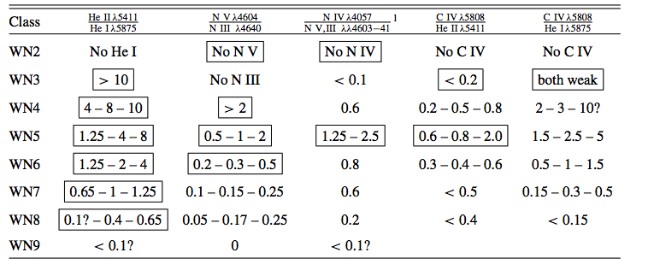
3D Classification – Ionization
Remove dependence on Nitrogen lines, use $He II λ5411$/$He I λ5875$ in addition
WN2: absence of He I, N III, N IV and N V
WN3: presence of He I, absence of C IV
WN4-WN6: relative strength of N V and N III
WN7/WN8: use He II/He I ratio
Notes:
He lines beneficial as they are usually isolated and uncontaminated. Not influenced by similar issues as nitrogen lines
Since He can fail, add in extra diagnostics from N lines as well
Use N for WN4-WN6 because of similarity of He ratio

Slide 12
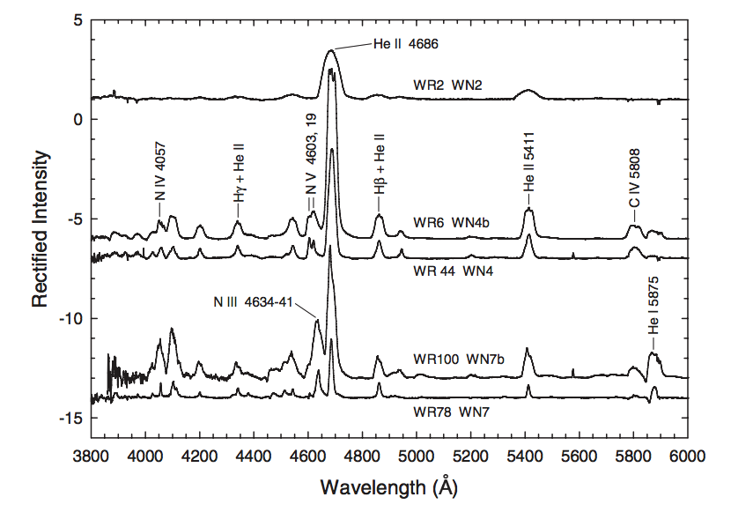
3D Classification – Line Width
Add “b” to classification
FWHM $He II λ4686>30$ Angstroms or FWHM $He II λ5411>40$ Angstroms

Slide 13
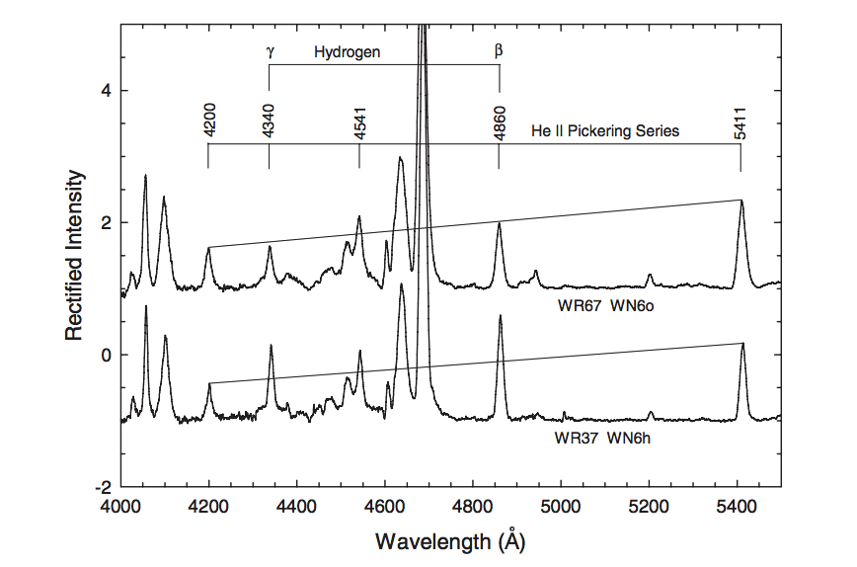
3D Classification – Hydrogen Abundance
If hydrogen present, add “h” to classification (relative increases in blended Pickering lines)
If hydrogen absent, add “o” to classification (monotonic decrease)
Notes:
So can tell if hydrogen present in the wind
WC stars show no evidence for hydrogen in wind

Slide 14
Ultraviolet Classification
WR stars emit most of their radiation in UV and FUV
Ions that are abundant in winds have their resonance here
No independent classification system though!
Use optical classifications to order UV/FUV features

Slide 15
IUE Ultraviolet Classification
Low resolution spectra from International Ultraviolet Explorer (IUE) used to classify in UV
Low resolution = most features are blends
Looking for systemic trends by ionization class is difficult due to varying continuum level
In general, identifying specific class is difficult
Will see late type dominated by P Cygni profile of metallic resonance lines
Note: only 9 WN and 5 WC stars in this sample
Notes:
-systemic trends difficult due to varying continuum level which is a function of temperature, continuous opacities and interstellar reddening
Can tell apart early and late easier, but other than that it is hard to tell
Importnant to note that best to study winds in this regime (P Cygni profiles!)

Slide 16
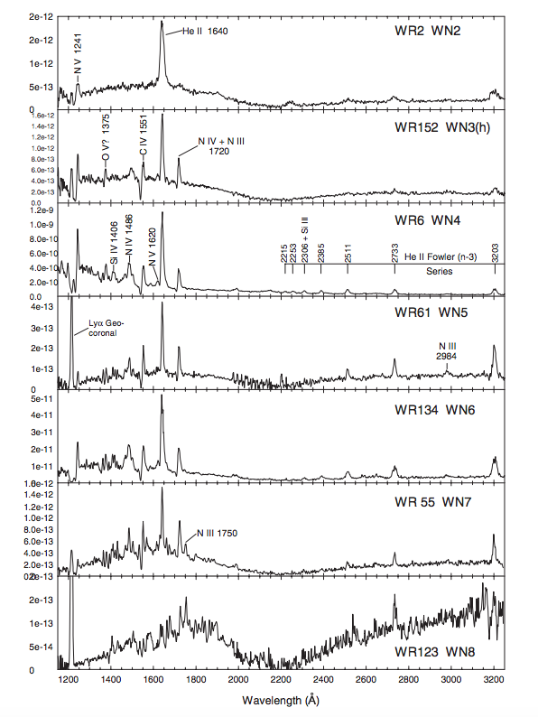
IUE Ultraviolet Classification – WN
Best correlation with WN class is N III/N V
Notice 2200 Angstrom bump
Higher resolution does not help improve classification in this region

Slide 17
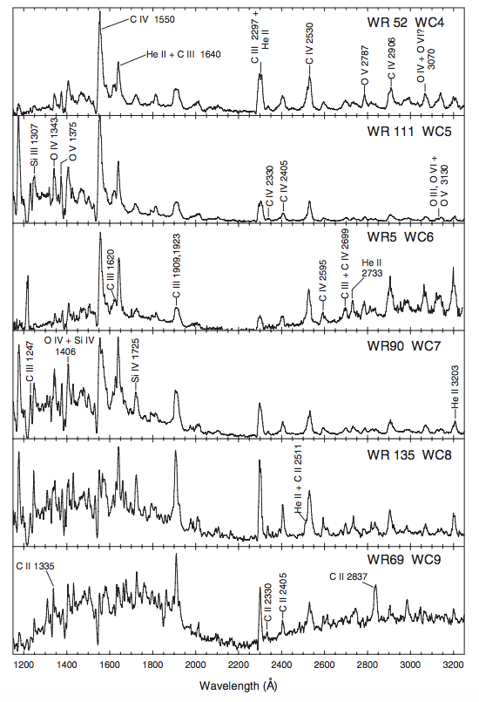
IUE Ultraviolet Classification – WC
Prime classifier: C IV/He II + C III
Note P Cygni for all classes with C IV
Classifier for stars later than WC5: C IV/C III
C II lines predominant in latest types

Slide 18
Far Ultraviolet (FUV) Classification
Observations from Far-Ultraviolet Spectroscopic Explorer (FUSE) assisted in study of WR stars in FUV
$λ<1000$Angstroms affected by interstellar absorption (i.e. Lyman-hydrogen, metallic resonances, $H_{2}$ bands)
For understanding classification, use LMC stars when possible
No massive WC stars in LCM later than WC4 though
Notes:
-most absorption seen in these spectra are from interstellar extinction!
-LMC stars are much less susceptible to galactic extinction

Slide 19
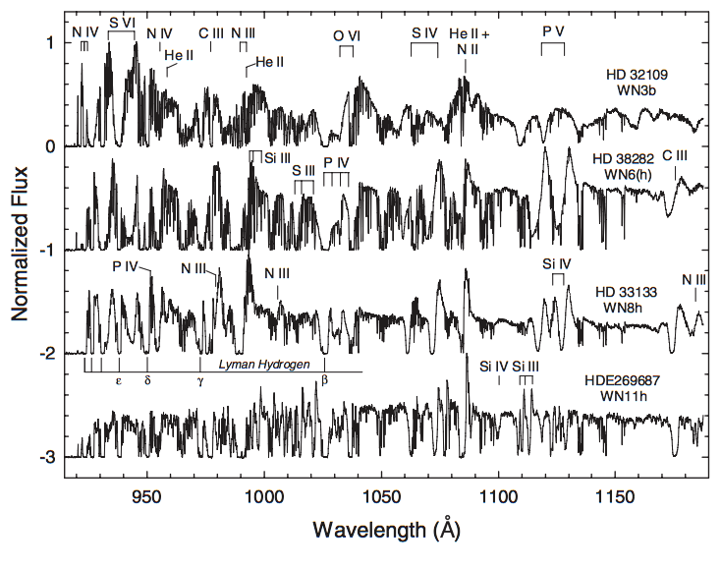
FUSE FUV Classification – WN
WN3: P cygni profiles of O VI and S VI
WN6: strengthening of S IV and P V
WN8: Addition of N III P Cygni
WN11: dominated by N II
Notes:
-WN3b is LCM star, p cygni profiles of high ionization lines (O VI and SVI)
-WN6 is LMC star, weakening of high ionization lines, strengthening of lower ones (S IV and P V), C III p cygni also developed
-WN8 is LMC star, now add addition of N III p cygni profiles
-WN11 is LMC star, lower ionization species dominate (dominated by N II)

Slide 20
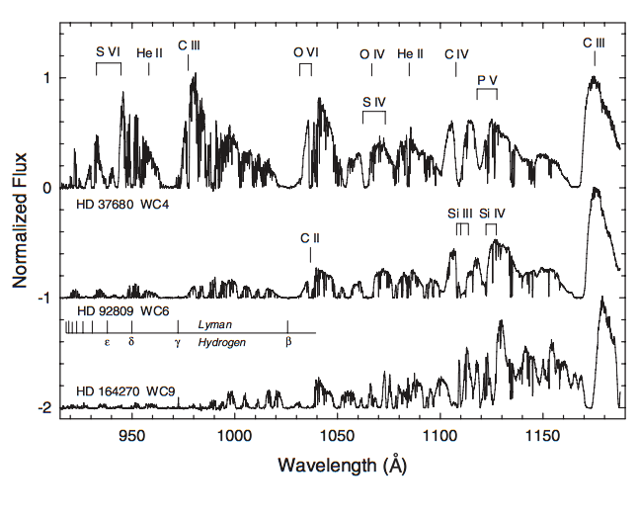
FUSE FUV Classification – WC
WC4: P Cygni in O VI, C III; P V absoprtion
WC6: Large C III still present, blends Si III and Si IV
WC9: Weaker P V absorption
Notes:
-WC4 is LMC star, shows pronounce p cygni in O VI and C III, though absorption components are saturated, also P V absorption!
-WC6 is milky way star, so lots of extinction in short wavelengths
W6 still has large CIII Pycgni, defining factor between this and previous type is the addition of blended Si III and Si IV lines (blend with the P V absorption)
WC9: P V absoption is weaker, so is C III P cygni

Slide 21
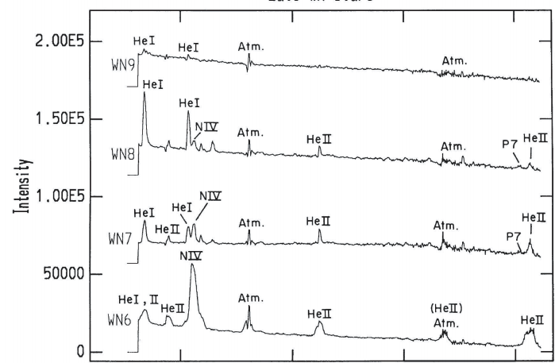
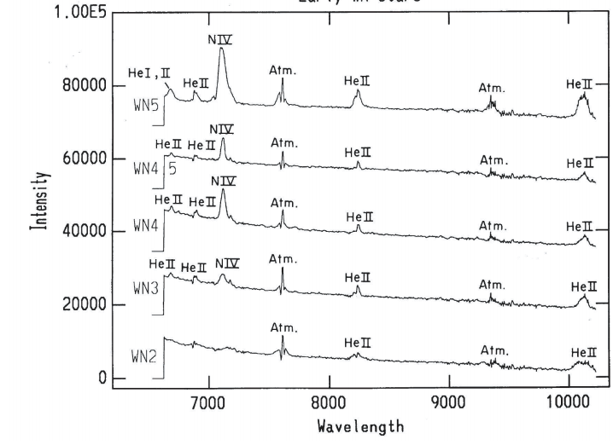
Near Infrared Classification – WN
Similar to IUE classification, can only tell apart the extremes
WN2: weak N IV
WN7-WN9: appearance of He I
All seem to show lines or He II n-5 series though

Slide 22
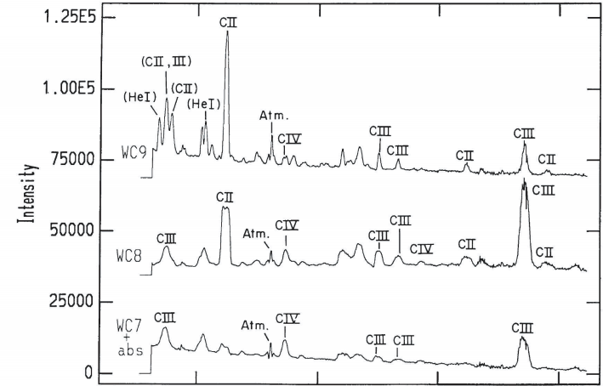
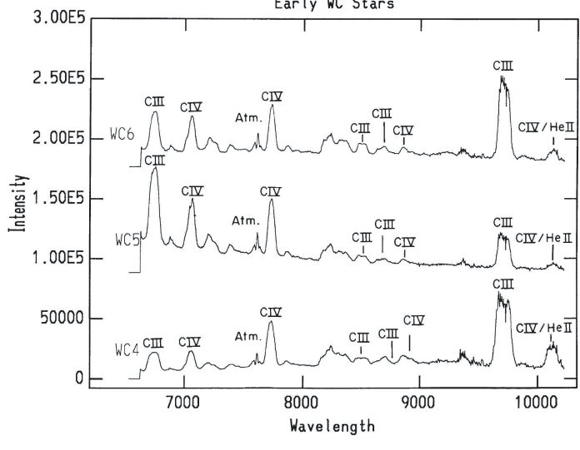
Near Infrared Classification – WC
Similar to WN, can only differentiate the extremes
Early WC: relative strength of C II and C IV
Later WC: strong C II
Issue is some lines subject to selective excitation and optical depth effects

Slide 23
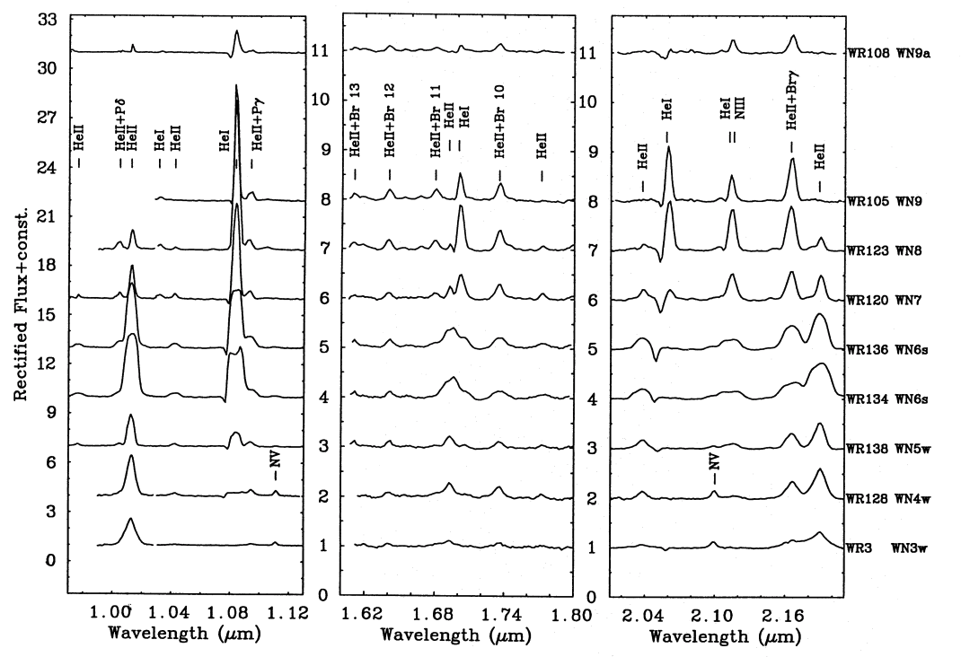
Infrared Classification – WN
I Band
H Band
K Band
Ionization correlated with He II/He I in I band
He II lines blended with Brackett lines for determining H/He ratio

Slide 24
Infrared Classification – WC
A system has been devised by Eenens et al. (1991)
Only based on eight stars!!!
Seem consistent with optical classification though
Generally, scheme separates late and early stars:
Early: strong O V in J-band
Late: C IV/CIII ratio in J-band
C IV/C III is K-band also seems promising for classification
Notes:
- Use C IV/C III to separate the early and late type stars

Slide 25
Luminous Blue Variables
Extremely luminous supergiants with instabilities that result in eruptions
Famous (and extreme) example: $η$ Carinae
Typical example: S Dor

Slide 26
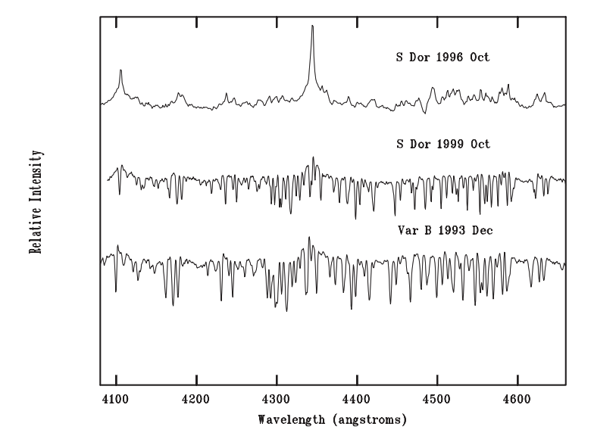
Luminous Blue Variables
Mass loss caused by eruptions lead to optically thick, extended atmosphere
Minimum light: T > 15,000 K, spectrum like luminous emission line star
Maximum light: 7,000 K < T < 8,000 K, spectrum like luminous A or F supergiant
Notes:
-T is temperature of pseudo photospehere (so all the stuff in extended atsmphere)
-whether it is giant or typical eruption, looks like luminous F supergiant in the spectrum

Slide 27
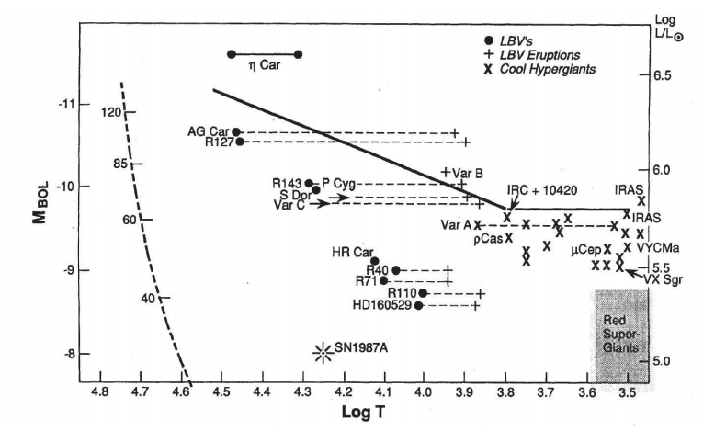
LBVs– HR Diagram
Notes:
-solid line is the Humphryes-Davidson limit (ie empirical upper limit on luminosity)
-eddington limit: luminosity at which radiation pressure exceeds gravitational attraction leading to distruption of the star
-sloped part is roughly the eddington limit, constant part is the temperature independent limit for late type hyper giants
-reason LBVs close to sloped limit is they are above critical mass (~40 solar masses) and encounter these inabilities
-during eruption, bolometric luminosity of star is constant, that pseudo photosphere crosses the limit though during these times
-note: bolometric luminosity not constant for giant erruptions

Slide 28
Connecting LBVs and WR stars
LBVs and WRs part of evolution of massive Of star
Would help explain absence of red supergiants at highest luminosities
Proposed evolution scenarios (mass dependent):
$O→WN\left(H−rich\right)→LBV→WN\left(H−poor\right)→WC→SNIc$ (~75 $M_{⊙}$)
$O→LBV→WN\left(H−poor\right)→WC→SNIc$ (~40-75 $M_{⊙}$)
$O→LBV/RSG→WN(H−poor)→SNIb$ (~25-40 $M_{⊙}$)
Notes:
-stellar winds reveal N from CNO products and C and O from helium burning, so like peeling an onion
-LBVs exact role is not clear at all, or how dominant its phase is in this process (still lots of uncertainty)

